Slide 1
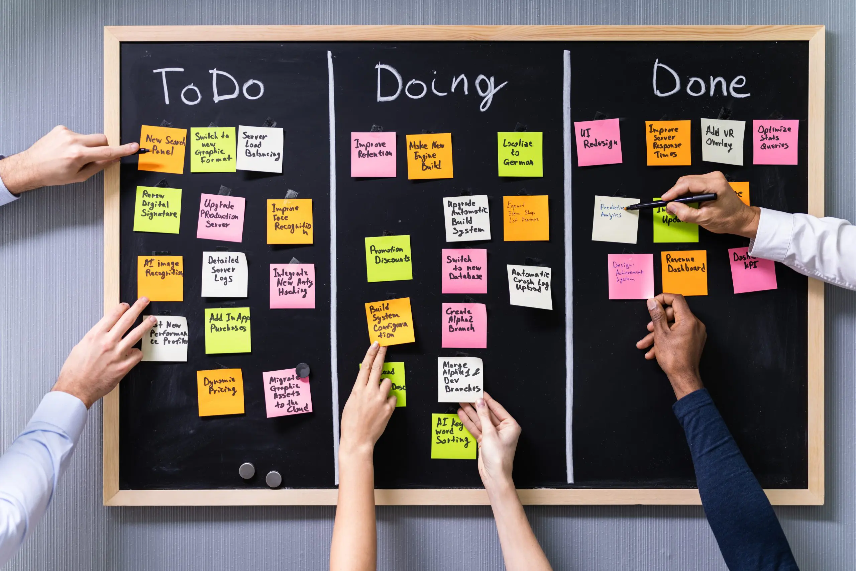
What is Kanban and Kanban Board
Kanban is an Agile project management method used to manage and improve work processes. It focuses on visualizing work, limiting work in progress (WIP), and improving flow.
In Kanban, work items are displayed on a Kanban board, usually divided into columns such as To Do, In Progress, and Done. Each task is represented by a card that moves across the board as work progresses. This helps teams see the current status of work, identify bottlenecks, and deliver work continuously without fixed iterations.
Key features of Kanban:
- Visual workflow using a board
- Limits on work in progress
- Continuous delivery and improvement
- Flexible and easy to adopt

Slide 2
Lean Principles
Lean principles aim to maximize customer value while minimizing waste. They focus on delivering high-quality products efficiently by improving processes and eliminating unnecessary activities.
The five core Lean principles are:
Define Value Understand what the customer actually values and focus on delivering that.
Map the Value Stream Identify all steps involved in delivering the product and remove steps that do not add value.
Create Flow Ensure work moves smoothly through the process without delays or interruptions.
Establish Pull Work is started only when there is demand, avoiding overproduction.
Pursue Perfection Continuously improve processes to reduce waste and enhance quality.

